Slide 1
My Romantic Relation With Powershell Generally
and with dbatools Especially
Magnus Ahlkvist, Data geek, Transmokopter SQL AB

Slide 2








Explore your PASS community
Own your career with interactive learning built by community and guided by data experts.
Get involved. Get ahead.
Free online webinar events
Local user groups around the world
Connect with the global data community
.org
Online special interest user groups
Learning on-demand and delivered to you
Get involved

Slide 3

Missed PASS Summit 2019?
Get the Recordings
Download all PASS Summit sessions on Data Management, Analytics, or Architecture for only $399 USD
More options available at PASSstuff.com

Slide 4

We are thrilled to say the first ever PASS Virtual Summit will be taking place this November!
We will be launching PASS Summit into a whole new world, and with that comes exciting opportunities with what we can offer you. We will go beyond simply moving sessions online to fully embracing everything a virtual environment can offer.
Find out more at PASS.org/summit

Slide 5






Thank you to our Global Sponsors and Supporters

Slide 6





And also to our Local Sponsors

Slide 7
Session contents
My powershell journey
DBATools
Migration – log shipping and more with DBATools

Slide 8
Why did I make this presentation?
Sharing is caring
Automation => Focus on fun stuff
”Let’s spend half a day automating a 15 minute manual task”

Slide 9
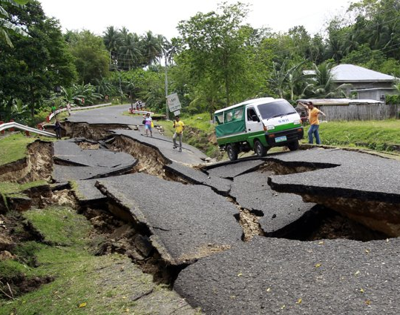
My Powershell journey
Det här fotot av Okänd författare licensieras enligt CC BY-NC-ND

Slide 10
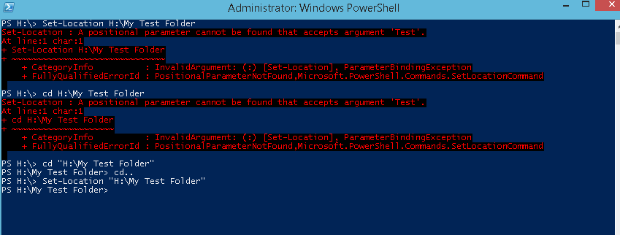
My Powershell journey, first iteration
This picture from unknown author licensed according with CC BY-SA

Slide 11


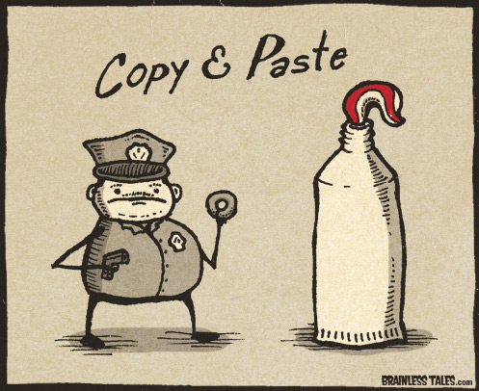
My Powershell journey, second iteration
This picure from unknown author licensed according with CC BY-SA
This picture from unknown author licensed according with CC BY-NC-ND
Det här fotot av Okänd författare licensieras enligt CC BY-SA-NC

Slide 12

My powershell journey, Nth iteration
Used with permission from Chrissy LeMaire

Slide 13
What is DBATools
Powershell module
Available on PowershellGallery
Command reference on dbatools.io/commands
Community driven
Use it
Contribute
Write code
Report bugs
Suggest features
Donate $$$

Slide 14
DBATOOLS First demo

Slide 15
Lets’s get down to business
Setup servers for backing up to and restoring from Azure blob storage
Install a new SQL Server instance
Automate patching of SQL Server
Migrate logins and jobs, setup log shipping

Slide 16
DBATOOLS Demo

Slide 17
Famous last words
Thank you GroupBy!
❤❤❤❤❤❤❤Thank you contributors of DBATools ❤❤❤❤❤❤❤
Automation replaces random mistakes with consistent errors.
That you can fix once.

Slide 18
This event was sponsored by Microsoft Learn more about SQL Server 2019 today: -Get free training: aka.ms/sqlworkshops -Download the SQL19 eBook: aka.ms/sql19_ebook

Slide 19


